Slide 1
Ward 1 Speaker Series
Planning and Development
April 22, 2021

Slide 2
Speakers
Andrew Whittemore – focus on Provincial framework
Jason Bevan – focus on Region/City Official Plans
Mary Ellen Bench – focus on Local Planning Appeal Tribunal

Slide 3
The Ontario Planning Framework
Andrew Whittemore
Commissioner, Planning & Building, City of Mississauga

Slide 4
Ontario Planning System – Top Down
Province – Minister of Municipal Affair & Housing
Regional Council – Growth Management Committee
City Council – Planning & Development Committee
Growth Plan Planning Act
Settlement areas Growth allocation
Mississauga OP Land-uses Zoning Bylaw
Provincial Policy Statement Local Planning and Appeal Tribunal (LPAT)
Employment lands High level polices
Ministerial Zoning Orders (MZO) Metrolinx
Heights & densities Urban design
Regional OP

Slide 5
Evolution of Ontario Planning Legislation
Bill 73
Smart Growth for Our Communities Act, 2015
Growth Plan
Growth Plan for the Greater Golden Horseshoe, 2017 (Places to Grow Act)
GP Amend
Growth Plan for the Greater Golden Horseshoe, 2019
Bill 108
Bill 139
Building Better Communities and Conserving Watersheds Act, 2018
PPS Amend
GP Amend
Provincial Policy Statement, 2019
Bill 7
Promoting Affordable Housing Act, 2016
More Homes, More Choice Act, 2019
Growth Plan for the Greater Golden Horseshoe - Land Needs Assessment Methodology, 2020
Bill 197
COVID-19 Economic Recovery Act, 2020

Slide 6
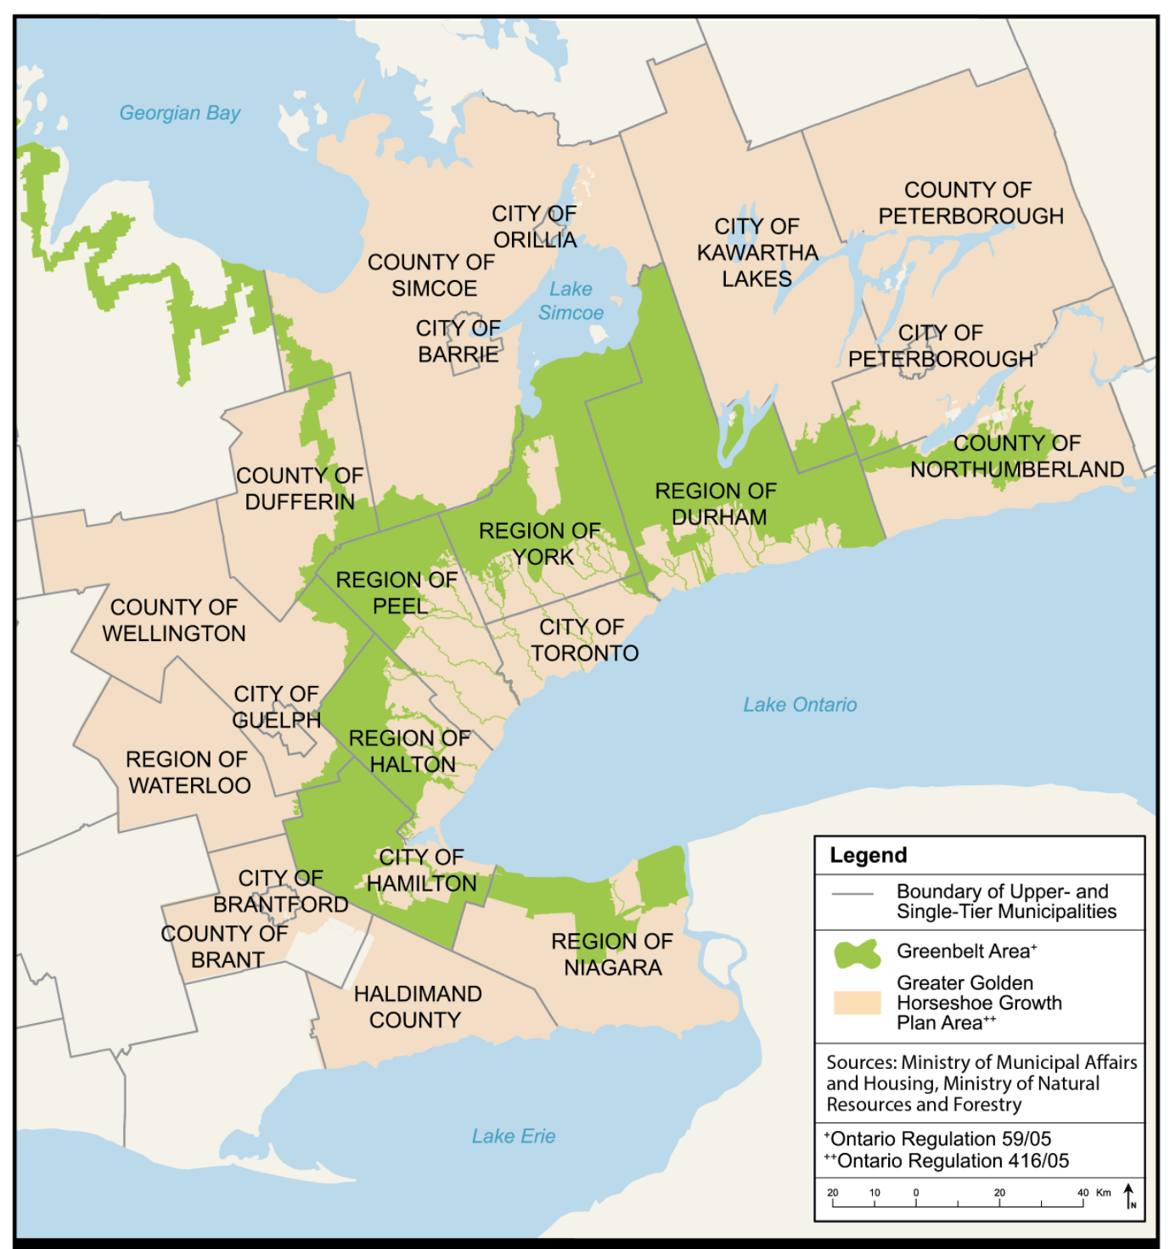
The Growth Plan (2006)
Establishes the long-term growth targets (population/employment)
Provides a policy framework to direct where and how growth occurs
  Prioritizes intensification in built-up areas (Minimum % infill and densities)
  Protects and enhances natural areas
  Integration land use planning with infrastructure investment
  Protects economic and employment areas
  Supports a range/mix of housing options (second units and affordable housing)
  Prioritizes climate change

Slide 7
Growth Plan (2006) Amendments
Policy Matter | Growth Plan 2017 | Growth Plan 2019
Settlement Area Boundary expansions | Restrictive onerous | Easier
Employment Areas conversion for residential uses | Restrictive onerous | Introduces priority employment areas
MTSAs delineation | Directs new growth | Directs new growth
Intensification target to encourage infill in existing urban area | Increases | Decreases
Density targets for greenfield (i.e. Caledon) | Increases | Decreases
Planning Horizon | 2041 | 2051

Slide 8
The Planning Act
Facilitates orderly change and efficient provision of services
Provides a legislative system to guide local land use planning
  Outlines roles and responsibilities of Province, Region and Cities
  Outlines decision-making authority and accountability of municipality
  Outlines planning processes for preparing official plans, zoning by laws, subdividing lands, seeking minor variances etc.
  Identifies tools to facilitate planning (CIP, Community Permit Systems, IZ)
  Outlines rights of land owners/residents (i.e. development application, notification, participation, appeal)

Slide 9
Planning Act Amendments
Policy Matters | Bill 73 | Bill 7 | Bill 139 | Bill 108
Protected Major Transit Stations (MTSAs) |  |  | Introduces new MTSA as focus of growth which are non-appealable | Maintains MTSAs as focus for growth and remain non-appealable
Inclusionary Zoning |  | Introduces permission to seek % of affordable housing |  | Reduced ability to apply IZ to MTSAs
Density Bonusing (Sec 37) |  |  |  | Proposed to replace with CBC
Parkland Dedication |  |  |  | Proposes reduced provisions
Built Form | Promotion of built form as a matter of provincial interest. |  |  | Proposes to eliminate importance

Slide 10
Planning Act Amendments
Process Matters | Bill 73 | Bill 7 | Bill 139 | Bill 108
Informing and obtaining the view of the public | Requires OP to define the approach |  | Maintained | Maintained
Review of new municipal official plans | Makes review mandatory every 10 years |  | Maintained | Maintained
Timelines for development applications decisions |  |  | Extends timelines for decision | Reduces timelines for decision
Appeals of new Official Plans. | No "global" appeals |  | Shelters certain municipally initiated Official Plan Amendments from appeal;
Official plan & zoning amendments | 2 year prohibition on seeking amendments to OP or Zoning bylaw |  | Places a two-year moratorium on amendments to newly approved Local Plans; | Maintains prohibition
Appeals | Identifies certain matters non appealable |  | Creates LPAT

Slide 11
Planning Act – Bill 197
1. Community Benefits Charge
Section 37 replacement
buildings over 5 storeys, with more than 10 residential units;
maximum charge is 4% of land value
can be appealed to the LPAT
2. Parkland Dedication
restored to current system
imposes rate for parkland calculations
can be appealed to the LPAT
3. Minister's Zoning Orders
Expanded powers to allow for inclusionary zoning and approval of site plans
Current proposal allows MZOs to be inconsistent with PPS

Slide 12
What Does This Mean To You?
Significant growth has been directed to the GTA
Mississauga has no greenfield lands - growth will be delivered as infill
Communities with declining populations, larger lots, old commercial strips, transitioning business, and brownfield sites, will feel pressure
LPAT places more weight on experts vs community stakeholders
Community has power to influence - LPAT is costly – most want to avoid
OP policy which is balanced and based on strong planning rationale can hold up at LPAT

Slide 13
Regional and
City Official Plans
Jason Bevan
Director, City Planning Strategies

Slide 14
Regional OP Key Policy Directions
Major Transit Station Areas – Boundaries and densities
Growth Allocation
Inclusionary zoning and affordable housing framework
Employment land protections / conversions
Settlement Boundary Expansion (outside Mississauga)

Slide 15
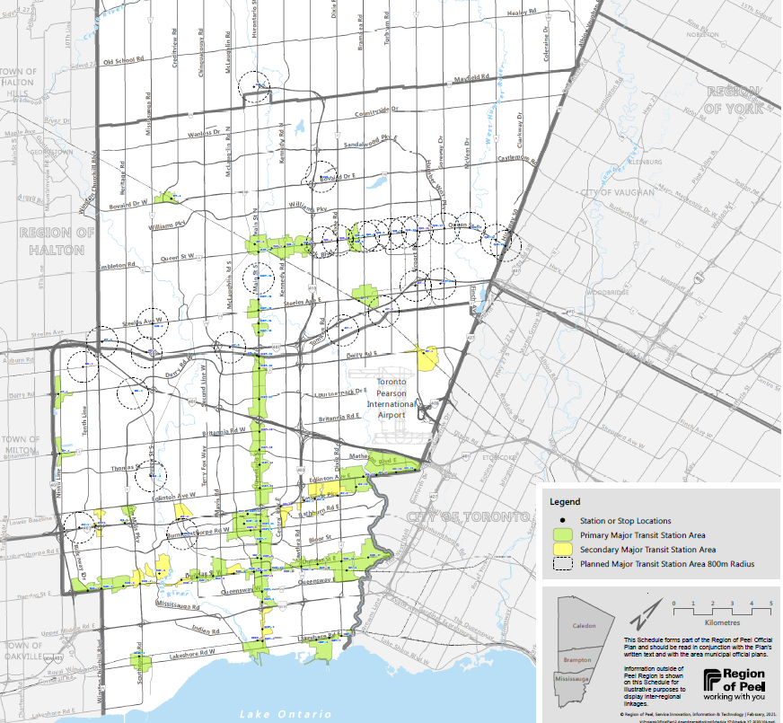
Major Transit Station Areas
Mississauga has over 60 Major Transit Station Areas.
Primary MTSA
Secondary MTSA
Notes:
This has been shared with the Province to review.

Slide 16
Regional Draft Growth Forecasts
Mississauga is forecast to have a population of close to a million by 2051.
 | Population |  |  | Employment
Municipality | 2016 | 2041 | 2051* | 2016 | 2041 | 2051*
Peel | 1,433,100 | 1,970,000 | 2,280,000 | 695,600 | 970,000 | 1,070,000
Mississauga | 748,400 | 920,000 | 995,000 | 476,700 | 565,000 | 590,000

Slide 17
Affordable Housing
Inclusionary zoning in MTSA areas
  % of units dedicated for affordable housing
Large site policy
Regional programs
  New purpose built rental incentives
  Second unit renovation grants

Slide 18
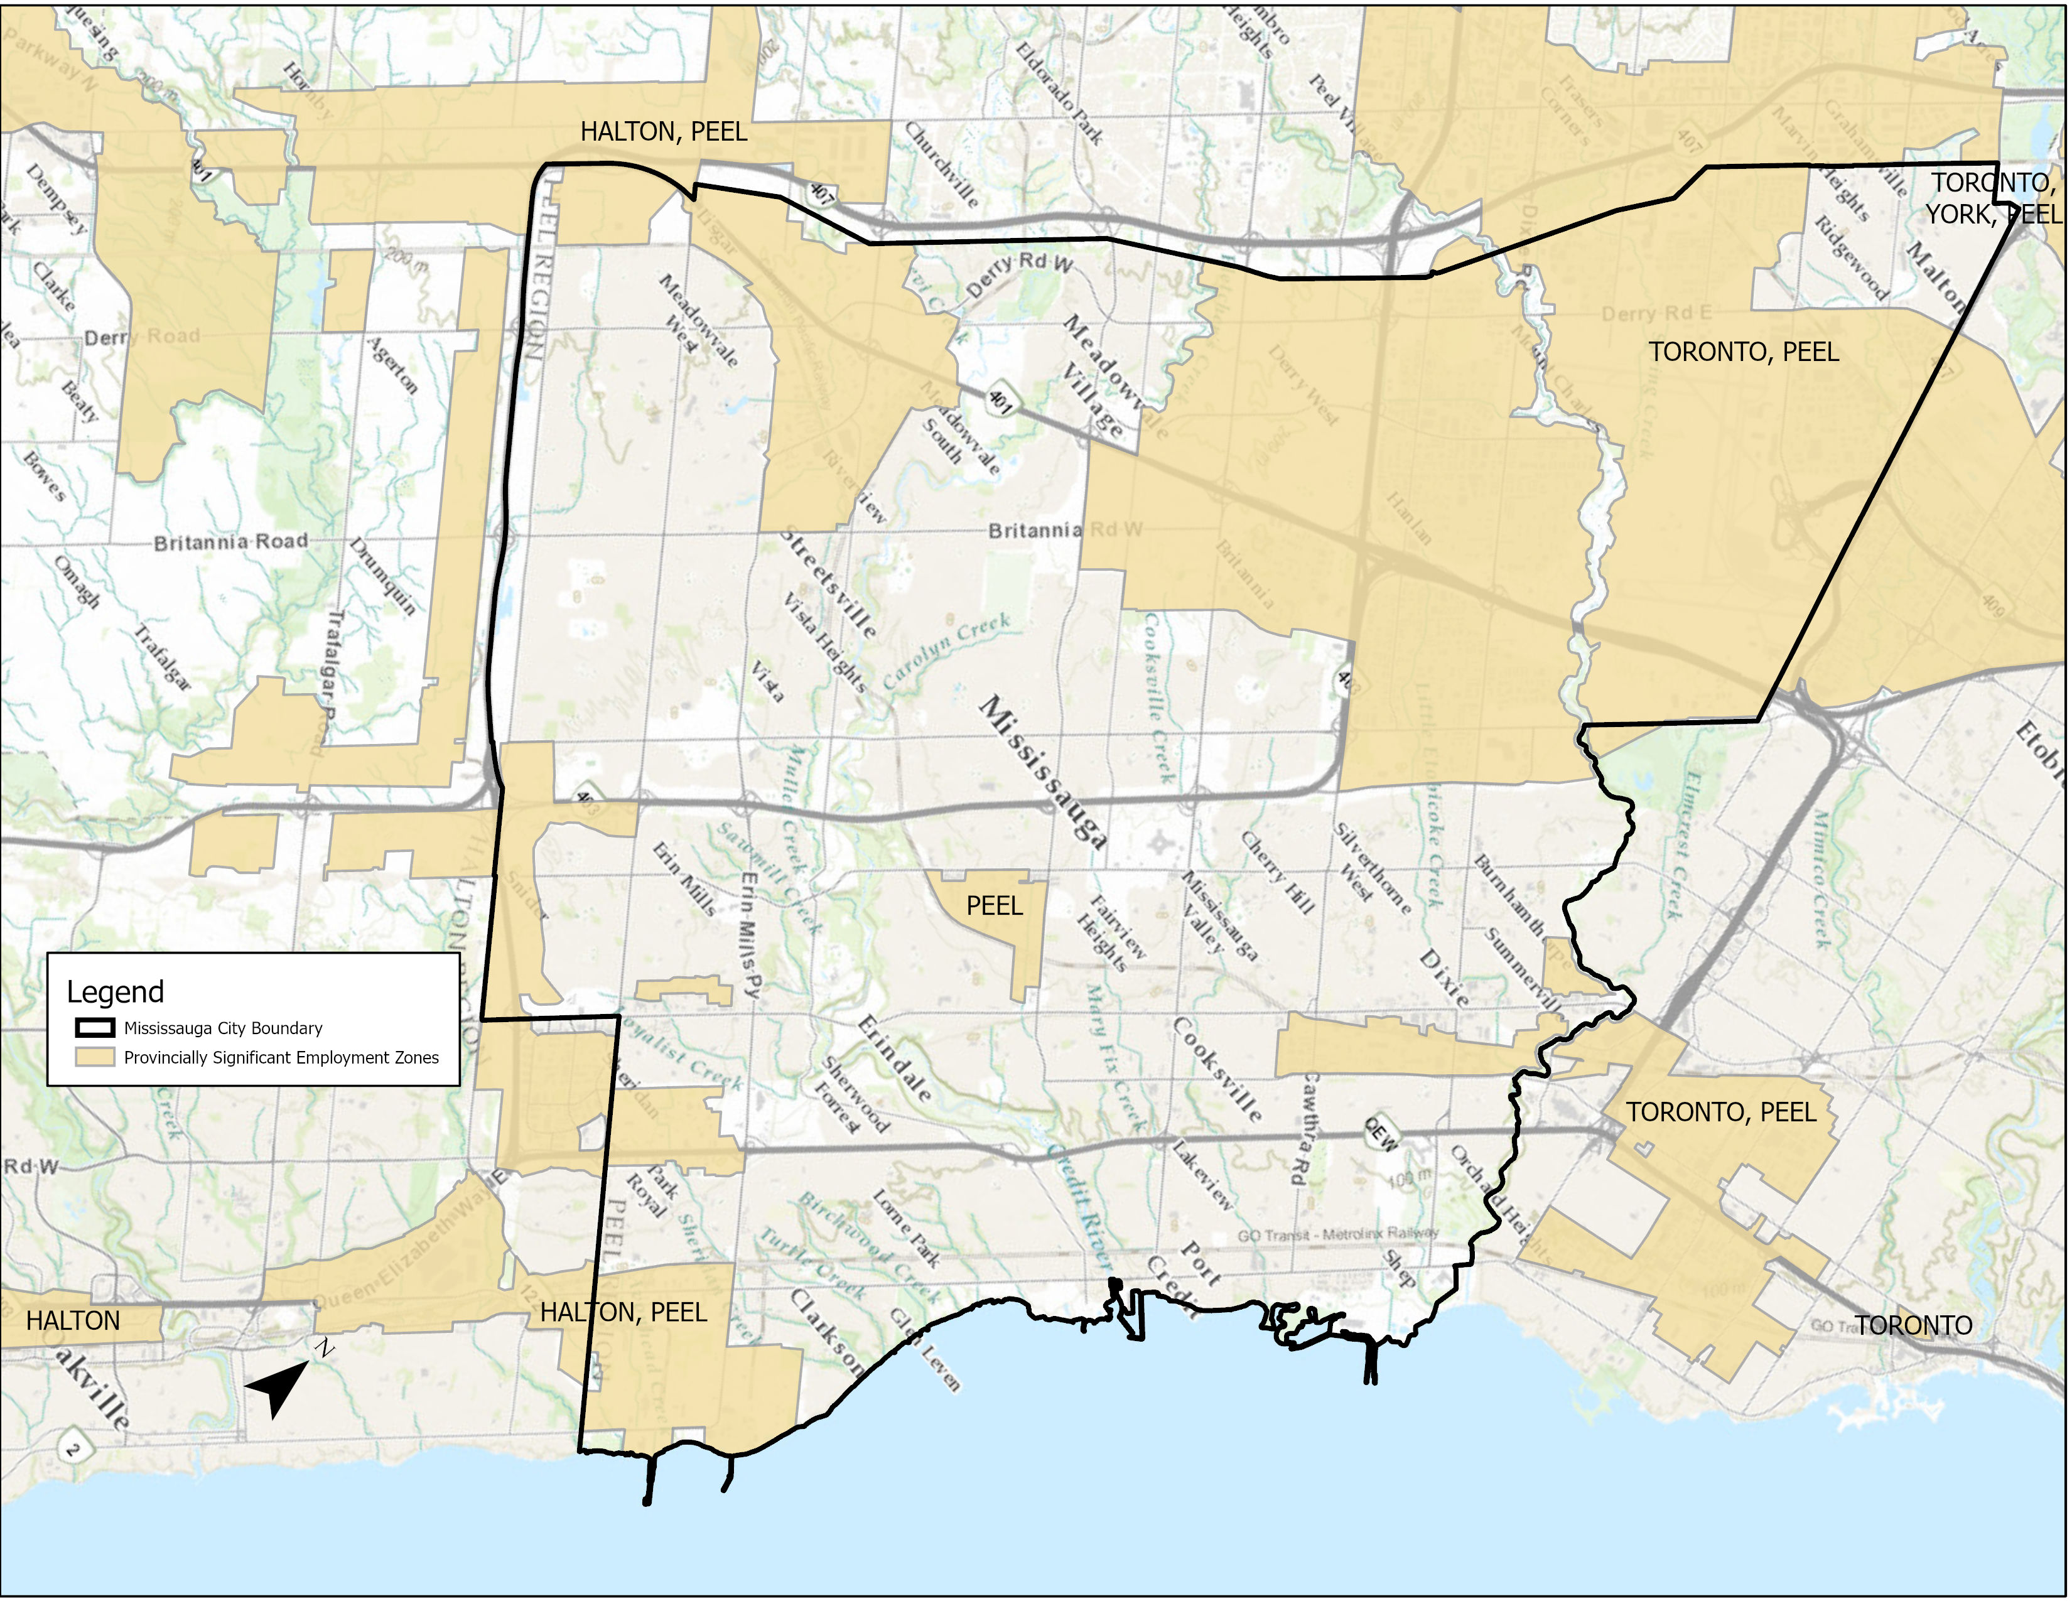
Economy
Mississauga is Canada’s 6th largest City
A vital contributor to the regional, provincial and national economy.
Almost all of the City’s employment areas are provincially significant.
Notes:
Approx. 97% of designated employment areas are within a Provincially Significant Employment Zone (PSEZ).

Slide 19
City OP Key Policy Directions
Major Transit Station Areas – Heights/densities
  Local area plans underway (Lakeshore through Lakeview, Cooksville, Hospital, Fairview)
Focus on office/retail retention and expansion
Gentle density and infill
Review parks, environment, transportation, heritage polices

Slide 20
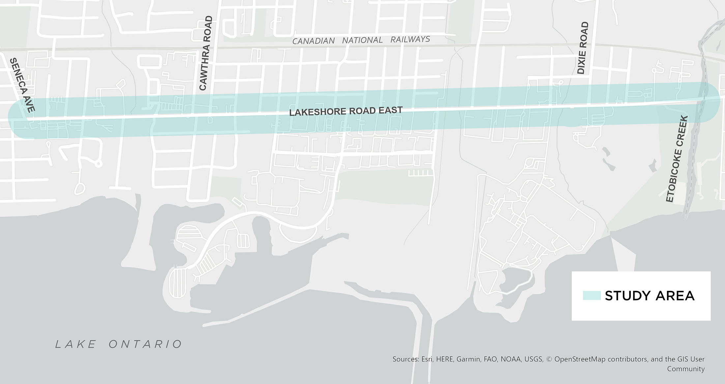
Lakeshore East Corridor Study
Refresh of elements of Local Area Plan
Touches two MTSAs
Look at heights, densities and urban design
Interactive community meetings May 4 & 5

Slide 21
Office and retail is important after COVID
Preserve planned function of retail uses as redevelopment occurs
  Reimagine the Mall
  LRT corridor
Requiring retail at grade in most new condo developments
Downtown office financial incentives and retention policies

Slide 22
Gentle Density in Neighbourhoods
Considered at April 19th Planning and Development Committee
Province requires municipalities permit 3 units on one existing lot
Also looking at other opportunities to allow for more types of uses that fit into neighbourhoods
  Duplexes that look like singles
  Look at lot size limits

Slide 23
City OP Next Steps
Website has briefs on: City Structure & Urban Design; Housing; Complete Communities; Environment; & Transportation
https://yoursay.mississauga.ca/official-plan-review

Slide 24
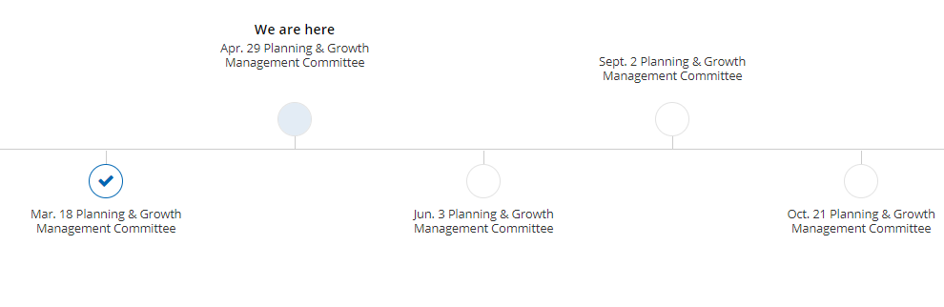
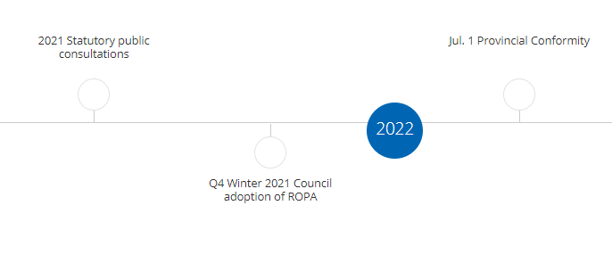
Regional OP Next Steps
https://www.peelregion.ca/officialplan/review/

Slide 25
Local Planning
Appeal Tribunal & land development
Mary Ellen Bench
Counsel, Dentons / Senior Advisor, StrategyCorp

Slide 26
What is LPAT?
Local Planning Appeal Tribunal
Provincial tribunal that independently hears appeals on land use planning and other matters
Appeals follow land use decisions made at Council or happen when Council has not made a decision in the time specified
Proceedings are governed by Rules of Practice and Procedure, similar to a court

Slide 27
What can be appealed to LPAT?
A Council decision to adopt/ amend an Official Plan or Zoning by-law
Refusals or non-decision by Council
Site plan (limited to owner) or subdivision refusals or non-decision
Committee of Adjustment decisions regarding minor variances and consent to sever applications

Slide 28
How does an appeal get to LPAT?
Filed with the City Clerk
Within the appeal period set out in the Planning Act
Pay the fee
Complete the appeal form and provide reasons based on the Planning Act
LPAT case coordinator assigned to manage the file

Slide 29
Next Steps
Notice of appeal will be screened and if valid, a Notice of Commencement is issued by LPAT Registrar
Case Management Conference (CMC) is mandatory

Slide 30
Parties and Participants
Parties are the City, the developer, the appellant (if different) and others who are accepted by the Board as parties at the first CMC
Parties must file submissions and present /cross- examine at the hearing
Participants play a limited role and may make submissions

Slide 31
Case Management Conference
Intended to define / narrow the issues
Appellant must serve and submit an Appeal Record by times specified and other parties will file responding material
Several CMCs may take place if the appeal is complex
Parties will set the amount of time required to hear the appeal

Slide 32
Motions
Motion hearings can be requested to seek dismissal of a matter; ask for directions from the Tribunal; ask for documents to be produced; ask for an adjournment
Notice of Motion and supporting affidavit must be served and filed
Copies of documents and caselaw if any, must be served and filed

Slide 33
Mediation
After the CMC mediation can be requested
Not a public proceeding
Intended to allow for resolution of some issues to shorten the hearing and sometimes mediation will resolve all of the issues
Tribunal member who presides over mediation will not hear the matter

Slide 34
The Hearing
Only parties can present evidence, cross-examine and make submissions
Notice will depend on the type of hearing, under the Rules
Hearing Plan submitted by the parties will establish how the hearing will proceed
Anyone can attend (most cases)

Slide 35
Some general information
Proceedings are not recorded so the Board Member will be taking notes to assist as the matter progresses
Be Prepared!
Tribunal time is valuable, so adjournments are very hard to get
The appeal process timing is hard to predict –short matters can be heard in 6-8 months, but complex appeals can take years, so be patient

Slide 36
How Do I Get Help?
LPAT Citizen Liaison can help
LPAT.CLO@ontario.ca or 416-212-6349
The LPAT Citizen Liaison can assist in explaining the process and the rules but cannot provide legal advice
LPAT Appeal Guide on LPAT website
LPAT forms, sample hearing plan, and past decisions are on the LPAT website to assist

Slide 37
Questions / Discussion

